Slide 1
Surface Physics
Tip-enhanced Raman Spectroscopy
Group 4
November 8, 2016

Slide 2
Contents
Principle and Development of TERS (田野)
Application of TERS
  Application in Physics (沈剑飞、秦茂森)
  Application in Chemistry (郄瑜、孙健)
  Application in Biology (黄宇亮、程博伟)
Summary

Slide 3
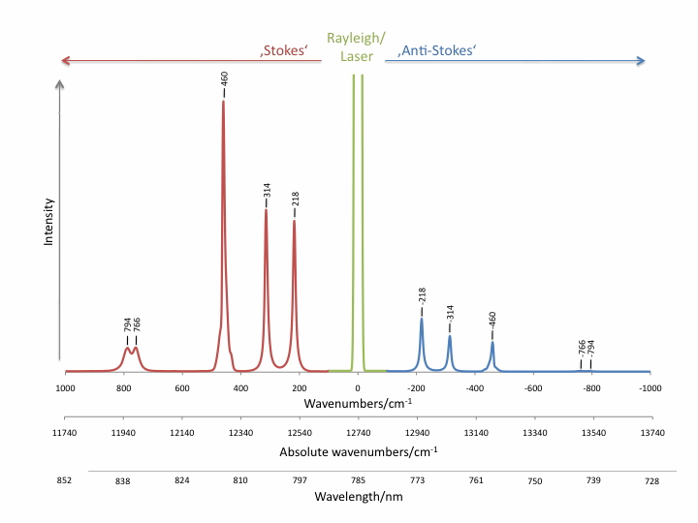
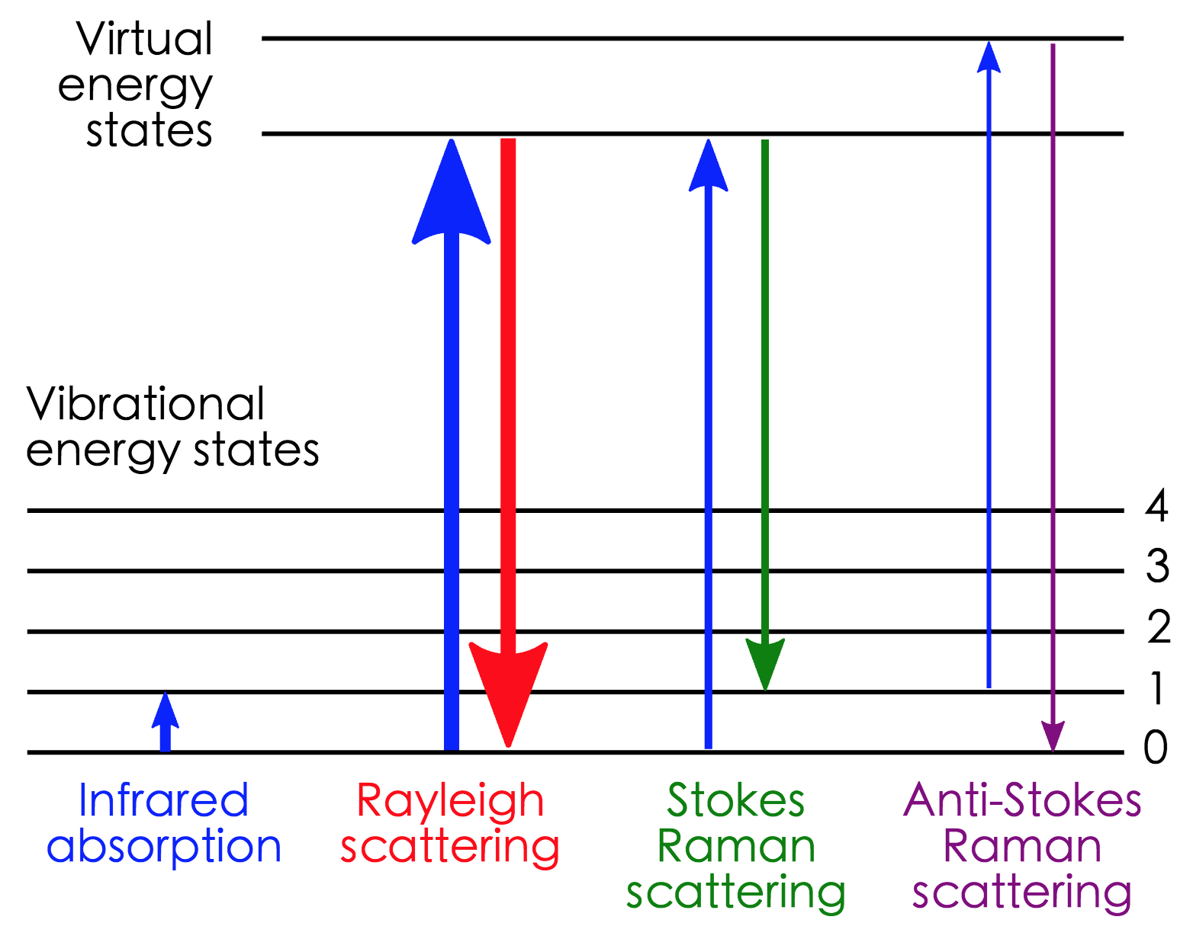


Raman Spectroscopy
$${10}^{−10}$$

Slide 4
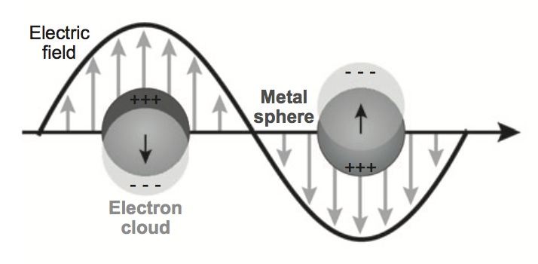
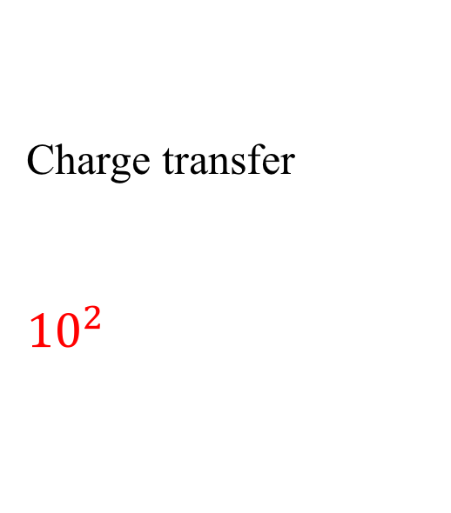

Principle of SERS
Electromagnetic Enhancement
Chemical Enhancement
Charge transfer
$${10}^{2}$$
$${10}^{6}$$

Slide 5
Development of TERS
SNOM
Raman
TERS
SERS

Slide 6
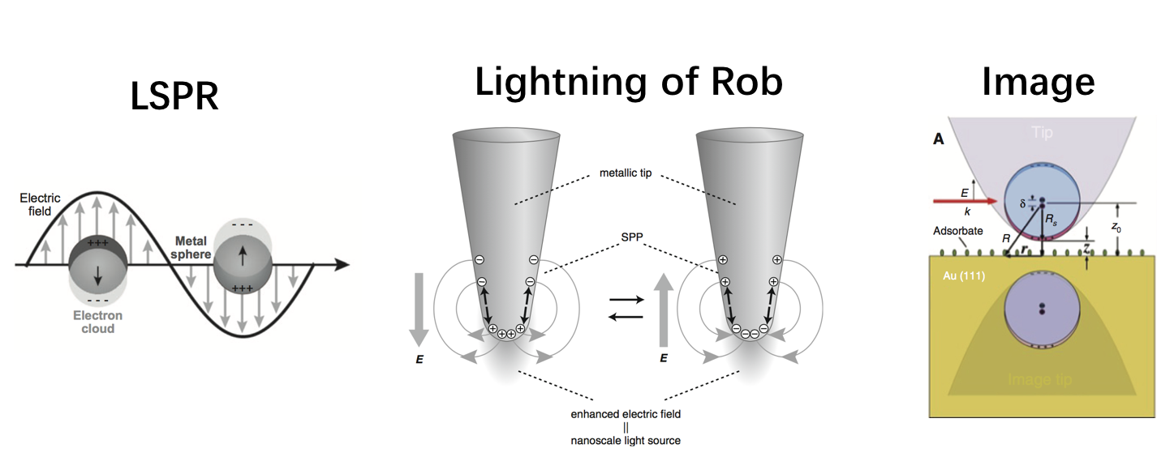
Principle of TERS

Slide 7
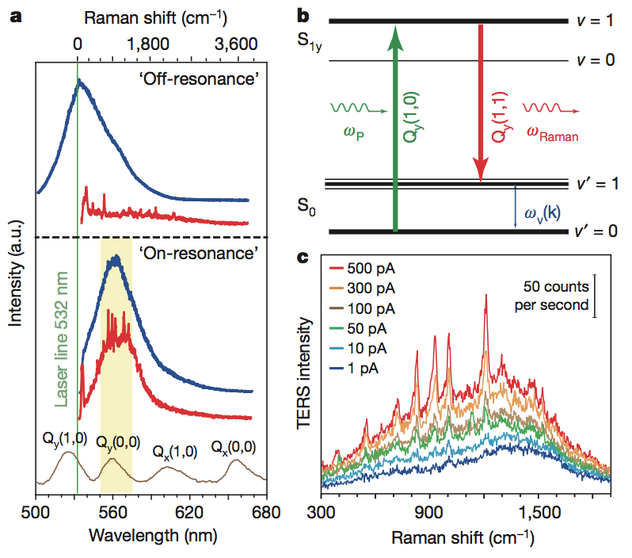
Higher-Resolution: Plasmon-Enhanced Raman Scattering
Zhang R, Zhang Y, Dong Z C, et al. Chemical mapping of a single molecule by plasmon-enhanced Raman scattering.[J]. Nature, 2013, 498(7452):82-6.

Slide 8
TERS in More Small Molecule
Duan S, Tian G, Luo Y. Visualization of Vibrational Modes in Real Space by Tip-Enhanced Non-Resonant Raman Spectroscopy[J]. Angewandte Chemie International Edition, 2016.

Slide 9
Advantage of TERS
High enhancement of Raman
High sensitivity
High Spatial Resolution
Nondestructive measurement
………

Slide 10
Application of TERS
Application in Physics
Stress Imagining of Semiconductor Surface
Phase-Breaking Property of Graphene
Application in Chemistry
Catalytic processes monitored
Organic solar-cells
Application in Biology
DNA Double Strand Breaks
Secondary Structure of Amyloid Fibrils

Slide 11
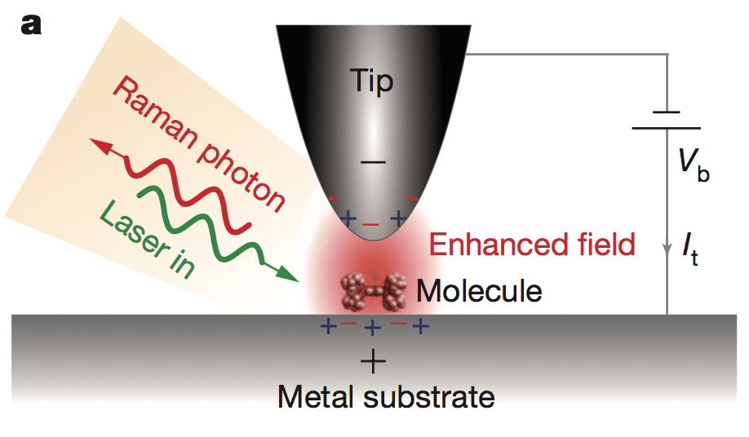
2. Application in Physics
Zhang R, Zhang Y, Dong Z C, et al. Chemical mapping of a single molecule by plasmon-enhanced Raman scattering.[J]. Nature, 2013, 498(7452):82-6.

Slide 12
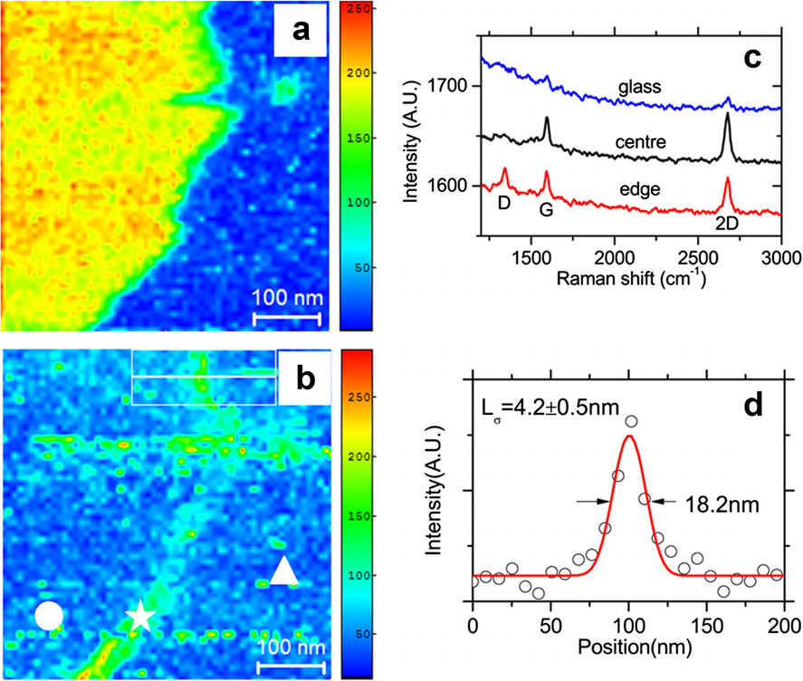
Phase-Breaking Property of Graphene
Pollard, Andrew J., et al. “Nanoscale Optical Spectroscopy: an emerging tool for the characterisation of 2D materials.” Journal of Materials NanoScience1.1 (2014): 39-49

Slide 13
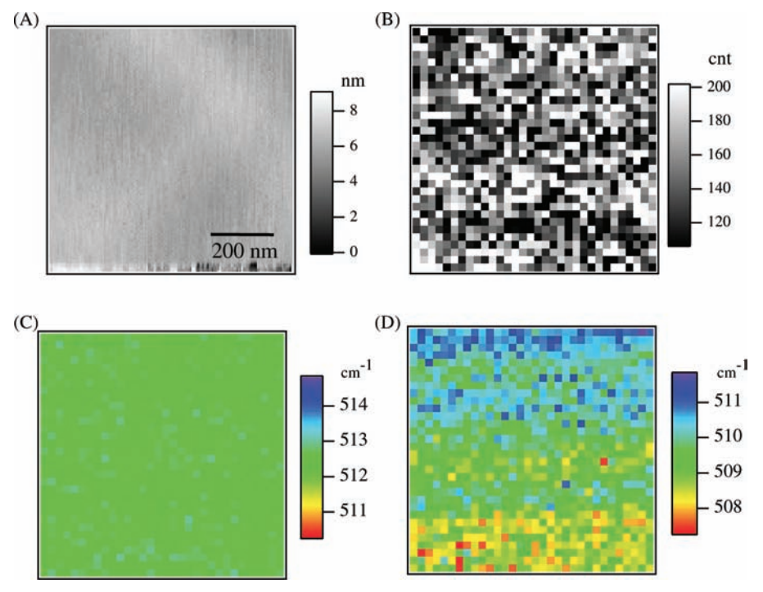
Stress Imagining of Semiconductor Surface
Saito Y, Motohashi M, Hayazawa N, et al. Stress imagining of semiconductor surface by tip-enhanced Raman spectroscopy.[J]. Journal of Microscopy, 2008, 229(2):217-22.

Slide 14
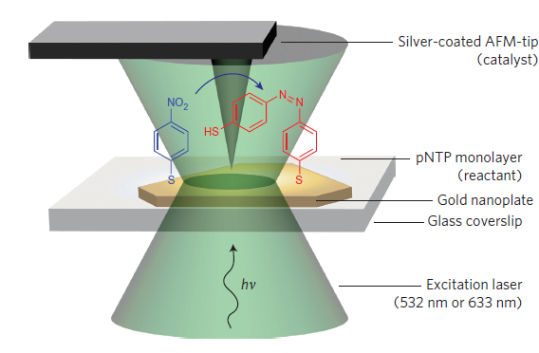
2. Application in Chemistry
Lantman E M V S, Deckert-Gaudig T, Mank A J G, et al. Catalytic processes monitored at the nanoscale with tip-enhanced Raman spectroscopy[J]. Nature Nanotechnology, 2012, 7(9):583-6.

Slide 15
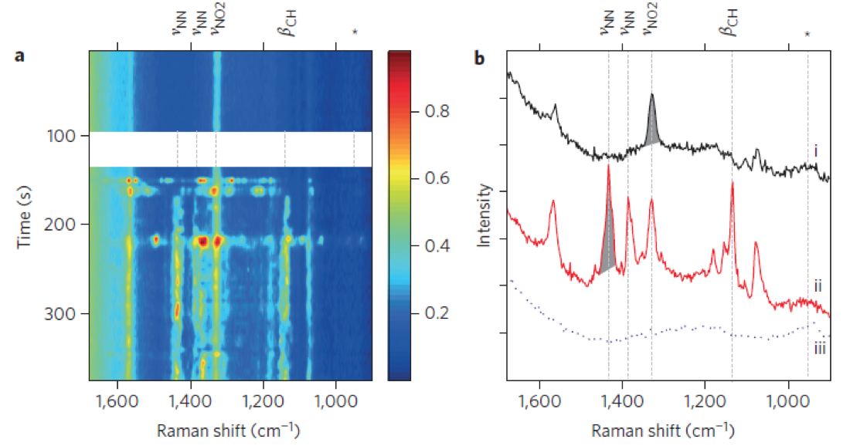
Catalytic processes monitored

Slide 16
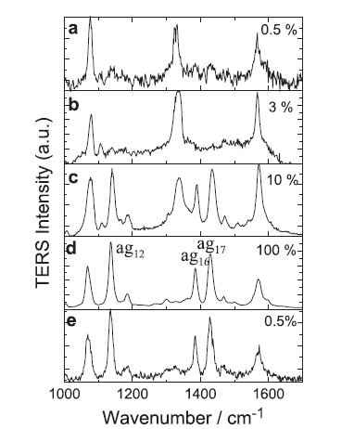
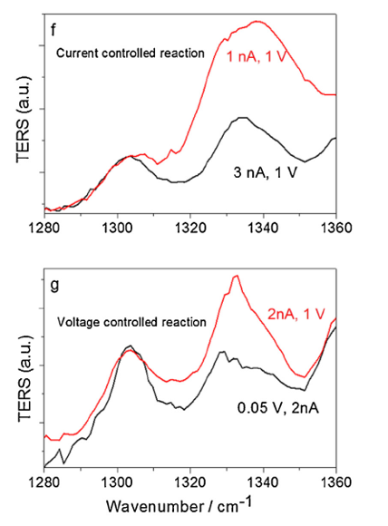
Catalytic processes monitored
PNTP
DMAB
Sun M, Zhang Z, Zheng H, et al. In-situ plasmon-driven chemical reactions revealed by high vacuum tip-enhanced Raman spectroscopy.[J]. Scientific Reports, 2012, 2(647):647-647.

Slide 17
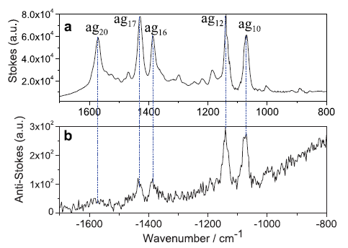
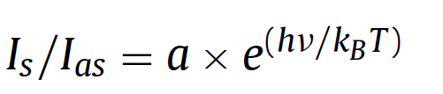
localized experimental temperature
T=327 (±4) K
Sun M, Zhang Z, Zheng H, et al. In-situ plasmon-driven chemical reactions revealed by high vacuum tip-enhanced Raman spectroscopy.[J]. Scientific Reports, 2012, 2(647):647-647.

Slide 18
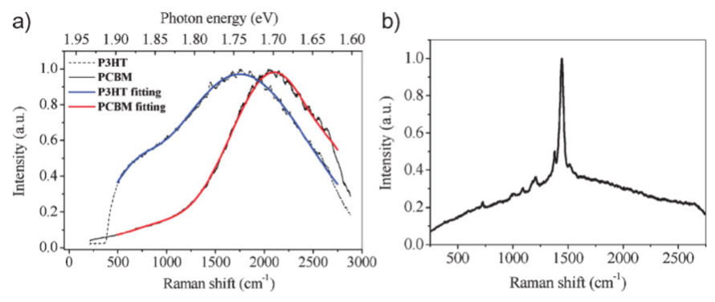
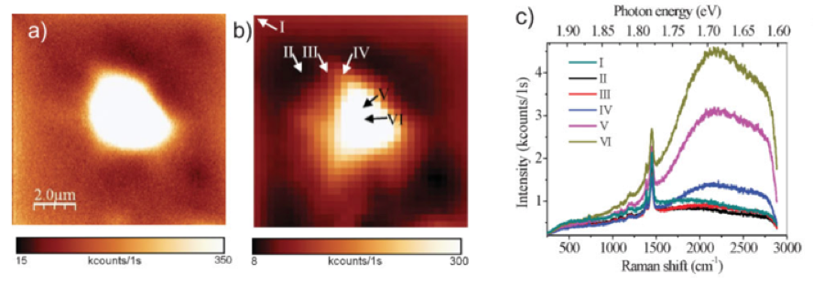
Organic solar-cells
P3HT
PCBM
Wang, Xiao, et al. "High‐Resolution Spectroscopic Mapping of the Chemical Contrast from Nanometer Domains in P3HT: PCBM Organic Blend Films for Solar‐Cell Applications." Advanced Functional Materials 20.3 (2010): 492-499.

Slide 19
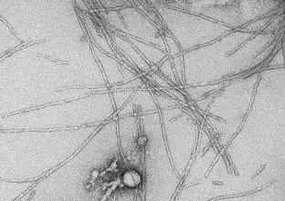
2. Application in Biology

Slide 20
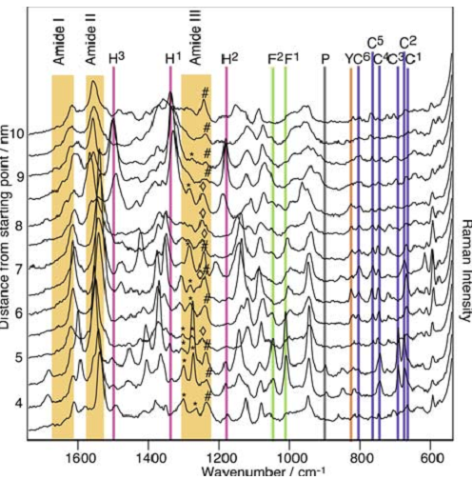
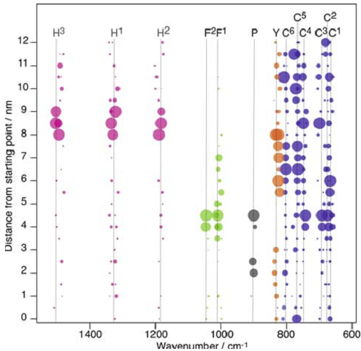
Exploring secondary structure of Amyloid fibrils
Deckert-Gaudig T, Kämmer E, Deckert V. Tracking of nanoscale structural variations on a single amyloid fibril with tip-enhanced Raman scattering.[J]. Journal of Biophotonics, 2012, 5(3):215–219.

Slide 21
Molecular Characterization of DNA Double Strand Breaks
Lipiec E, Sekine R, Bielecki J, et al. Molecular Characterization of DNA Double Strand Breaks with Tip-Enhanced Raman Scattering †[J]. Angewandte Chemie International Edition, 2014, 53(1):169-72.

Slide 22
Summary
Development in the Fortune
Higher Spatial Resolution (to A)
Combine With Time Resolution
…….

Slide 23
Surface Physics
Thanks for your Listening！
Group 4
November 8, 2016

